Slide 1


STRESS DETECTION WITH MACHINE LEARNING
SUBMITTED TO:-
Mr. SANJAY MADAN
PRESENTED BY- Arpit Shrivastav
CENTRE FOR DEVELOPMENT OF ADVANCED COMPUTING

Slide 2
TABLE OF CONTENT:-
INTRODUCTION
OBJECTIVES
FLOW DIAGRAM
METHODOLOGY
LOGISTIC REGRESSION
CONFUSSION MATRIX
CONCLUSION

Slide 3

INTRODUCTION:-
Relaxation gives health whereas stress affects your health. In the present day, situation Stress is most rapidly increasing. This is why people are not happy despite prosperity.
So this project will help to determine weather a person is suffering any type of stress or not as stress can not be detected easily in the earlier state. So to prevent stress it is to be first detected timely.
So in this project we are going to detect stress with the help of the Sentences that people use in their day to day life.

Slide 4
OBJECTIVES:-
To study various dataset available on stress detection project.
To develop the model with machine learning for the stress detection.
To detect and check weather person is suffering from stress or not.

Slide 5
WORK FLOW DIAGRAM
DATASET
PRE-PROCESSING DATA
DATASET
MODEL CLASSIFIER
FEATURE EXTRACTION
DATASET
STRESS
NO STRESS

Slide 6
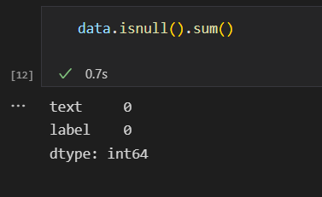
METHODOLOGY:-
DATA CLEANING :-
a) Checking for the missing value and removing the null columns.
b) Renaming the columns.
c) Removing the rows containing duplicated entries.

Slide 7
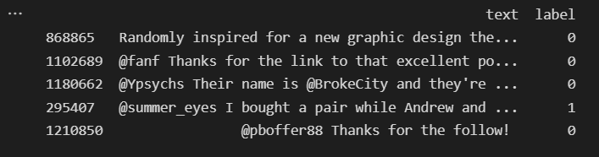
2. DATA PROCESSING:-
First we have collected the positive and the negative tweets.
After the collection of the data we have labelled the data(0 for NO STRESS and 1 for STRESS).
Then combine the both tweets and shuffle the dataset.
FINAL DATASET 2303 rows × 2 columns.
Then later we have used nltk to and Regex library of python to clean the text columns.
This is the new csv file that we have worked on and later on applied our machine learning models on it.

Slide 8
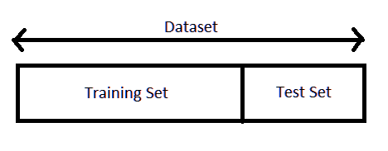
DATA SPLITTING:-
Splitting data: We must separate our data into target feature(y) and predicting feature(x).
Feature scaling: to standardize all the data values so that they will lie within the binary range[0,1].
Train-Test split: we split – training set and testing set in
70:30 ratio.

Slide 9
BUILDING THE MODEL:
* First we created a baseline model with NAÏVE-BAYES algorithm then predicted with other ML models like Random Forest classifier, Decision tree classifier and LOGISTIC REGRESSION.
* We observed that logistic regression model gave the best accuracy among all the models we applied i.e. (score=.91)

Slide 10
COMPARISON TABLE:-
SR.NO. | ALGORITHM | SCORE
1. | NAÏVE BAYES | 0.889474
2. | LOGISTIC REGRESSION | 0.914474
3. | DECISION TREE | 0.910526
4. | KNN | 0.888158
5. | SVM | 0.912105
6. | RANDOM FOREST | 0.911842

Slide 11
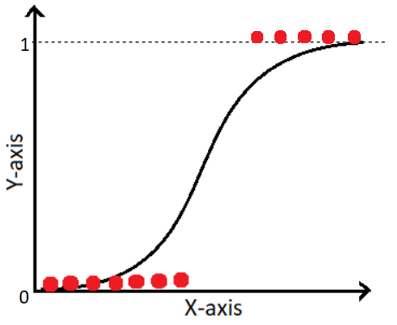
LOGISTIC REGRESSION :
Supervised Learning technique.
It is used for solving the classification problems.
In logistic regression, we use the concept of the threshold value, which defines the probability of either 0 or 1. Such as values above the threshold value tends to 1, and a value below the threshold values tends to 0.

Slide 12
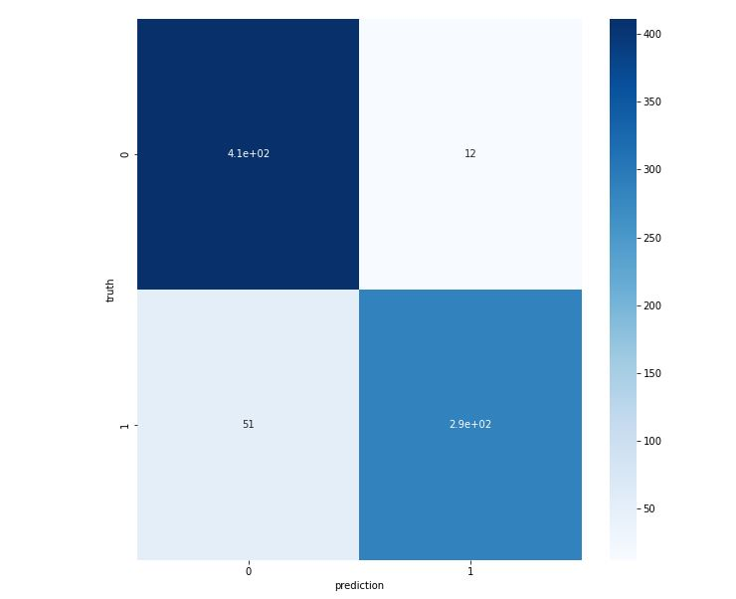
CONFUSION MATRIX:-
A confusion matrix is a visual representation which tells us the degree of four important classification metrics:
True Positives (TP): The number of observations where the model predicted the stress (1), and the person actually had stress. (1)
True Negatives (TN): The number of observations where the model predicted the no stress (0), and the person actually do not have stress (0).
False Positives (FP): The number of observations where the model predicted that person has stress (1), but in real life he/she do not have stress (0).
False Negatives (FN): The number of observations where the model predicted that person has no stress (0), but in real life he/she do have stress (1).

Slide 13
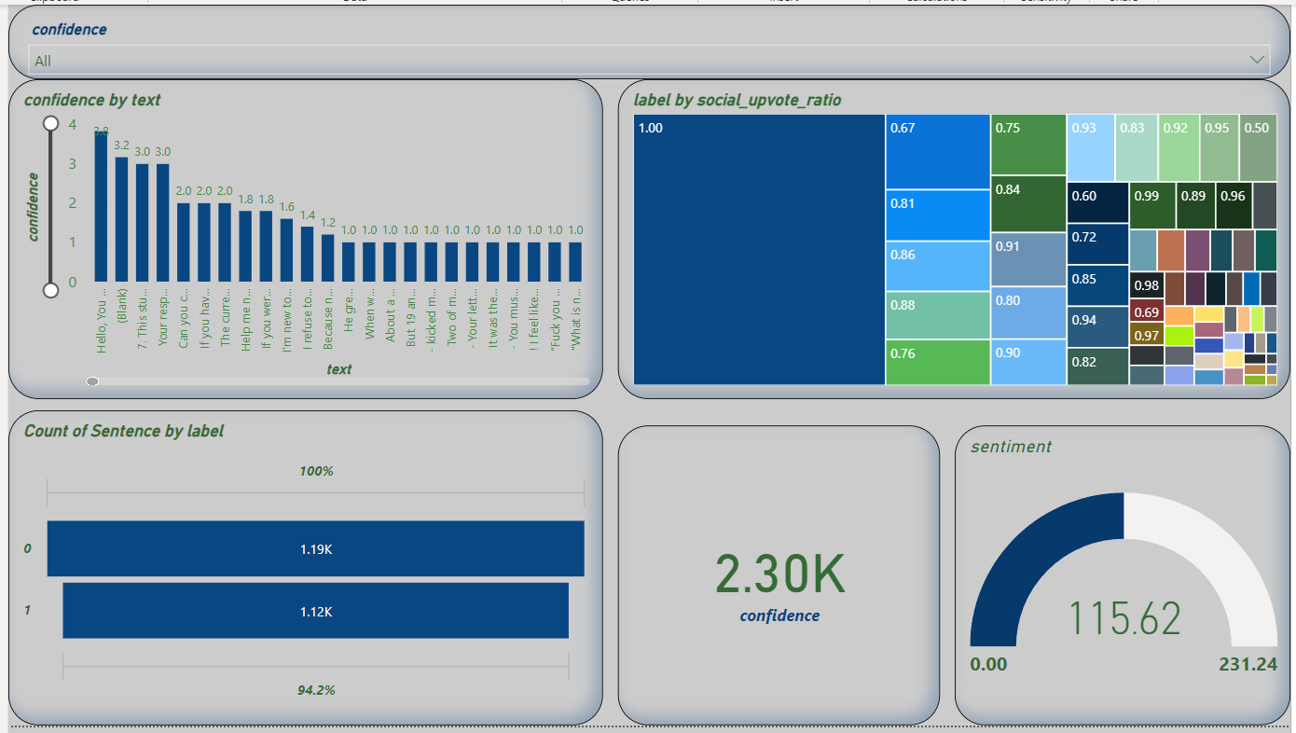
DASHBOARD MADE WITH POWER BI:-

Slide 14
CONCLUSION:-
In this project we can detect the stressful tweets collected from the dataset or we can take any tweet from the social sites or blogs and can check whether the writer is in stress or not.
We have used the various machine learning algorithms such as Naïve Byes, KNN, Random forest classifier, Decision tree and Logistic regression.
But the best one algo with which we have trained our model is Logistic regression as it is giving the highest accuracy score.
Also we have analysed the Various data patterns with the help of POWER BI where we have designed the dashboard that you have seen in previous slide.

Slide 15
THANK YOU

